Slide 1

Balancing the Scales: Navigating College Affordability in Contrast to U.S. Median Household Income
TEAM KAIZEN
Prof. F Brett Berlin
DEAN690

Slide 2










Our Team
Product Owner
Scrum Master
Developer
Developer
Chaitanya Pallamareddy
Sai Krishna Marikukala
Keerthi Reddy Chintareddy
Prasanna
Lakshmi
Developer
Developer
Sahith Patlori
Narasimha Vemuganti

Slide 3

Under the Guidance of
Prof. F Brett Berlin

Slide 4



Our Partner
Bahar Akman Imboden, PhD Managing Director, Founding Member
Hiba Agha, M.A. Director, Strategic Initiatives

Slide 5

ABOUT HILDRETH Institute
The Hildreth Institute is a non-profit organization that works to promote social justice and fairness on a variety of fronts, including economic, environmental, racial, and democratic transformation.
Interdisciplinary Approach: The institution addresses structural inequities and fosters positive social change by combining research, activism, education, and community participation.
Individuals and communities are empowered by the Hildreth Institute's collaborative relationships and grassroots participation to advocate for change and shape policies that address injustice and oppression.

Slide 6
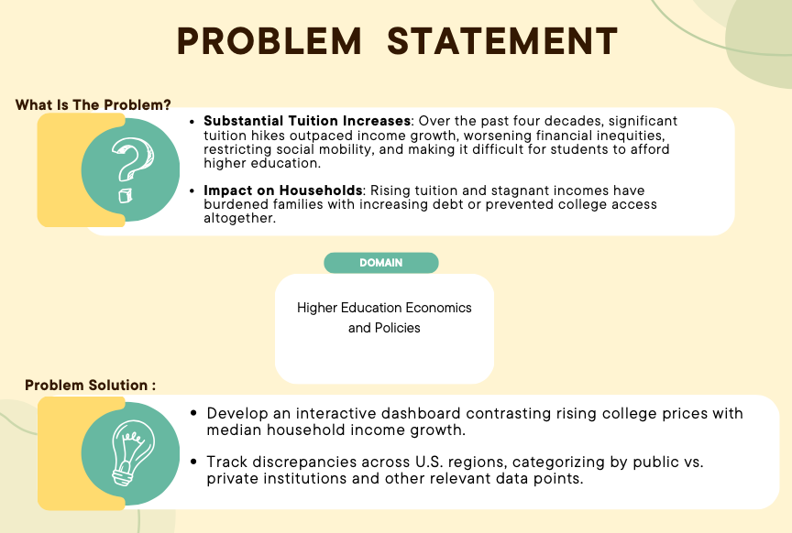

Slide 7

DATA SOURCES
Data Owner: Integrated Postsecondary Education Data System (IPEDS) Data Center (NCES)
IPEDS (NCES): The Integrated Postsecondary Education Data System (IPEDS), maintained by the National Center for Education Statistics (NCES), is a comprehensive data collection program.
Tuition Fees and Costs: It provides detailed datasets on tuition fees, room, and board costs, offering insights into the expenses of postsecondary education institutions across the United States.
Data Owner: Federal Reserve Bank of St. Louis
FRED: The Federal Reserve Economic Data (FRED) is an extensive economic database maintained by the Federal Reserve Bank of St. Louis.
Economic Indicators: It provides a wealth of data on economic indicators, including median household income, which is crucial for analyzing income trends and economic health across U.S. regions.

Slide 8

Data Attributes
Unit ID (Type: Integer)
Institution Name (Type: Character)
State (Type: Character)
Year (Type: Integer)
Median Income(Type: Integer)
Control of Institution (Type: Character)
Tuition fee for In-District students (Type: Integer)
Tuition fee for In-State students (Type: Integer)
Tuition fee for Out of state students(Type: Integer)
Cost of living for On Campus Students(Type: Integer)
Cost of living for Out of campus With Family(Type: Integer)
Cost of living for Out of campus Without Family(Type: Integer)
Off-campus with family other expenses(Type: Integer)
Off-campus without family other expenses(Type: Integer)
Cost of Books and Supplies(Type: Integer)

Slide 9
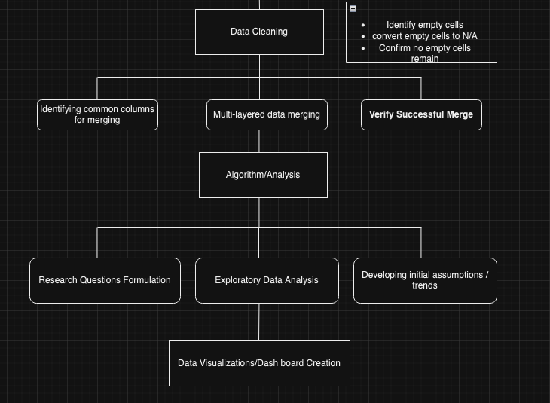
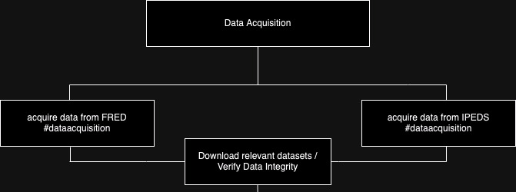
Data Architecture

Slide 10
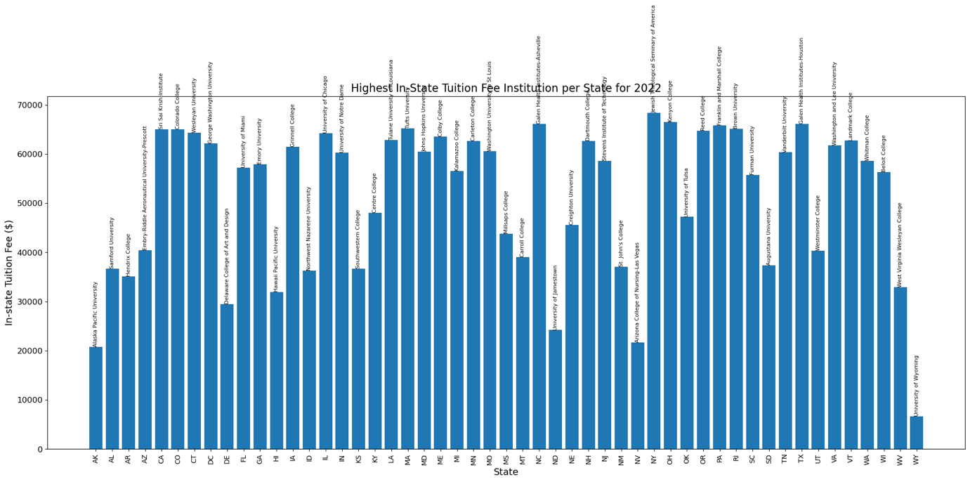
Exploratory data analysis

Slide 11
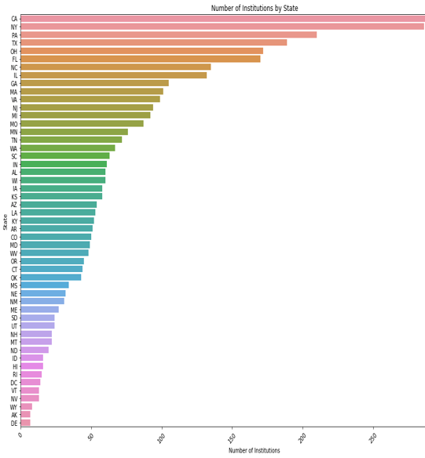
Exploratory Data Analysis
Institutions per state , in cronological order.

Slide 12
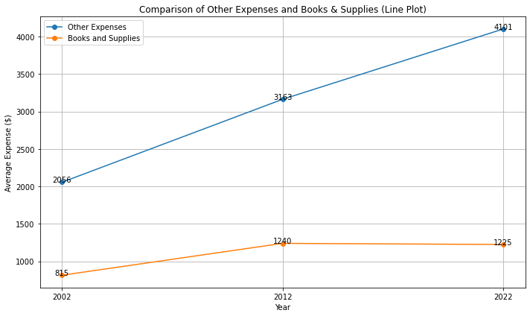
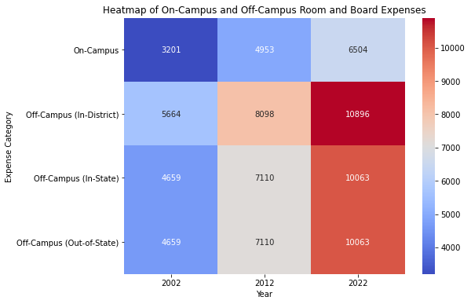

Slide 13
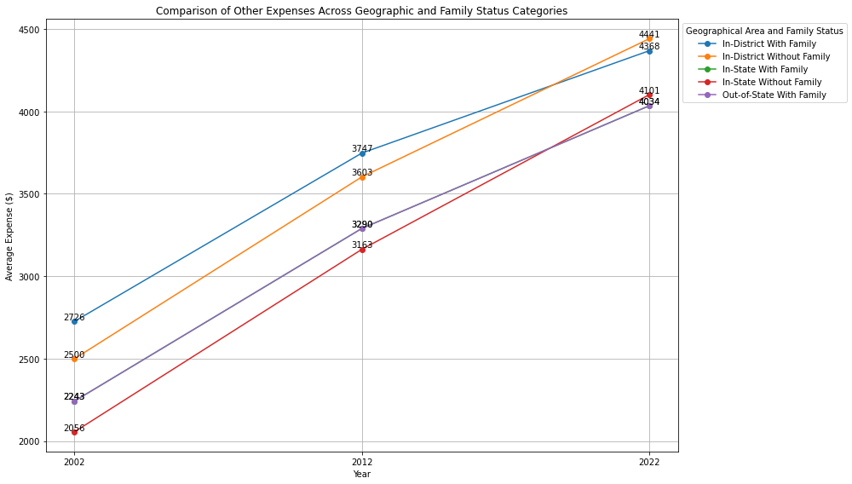

Slide 14
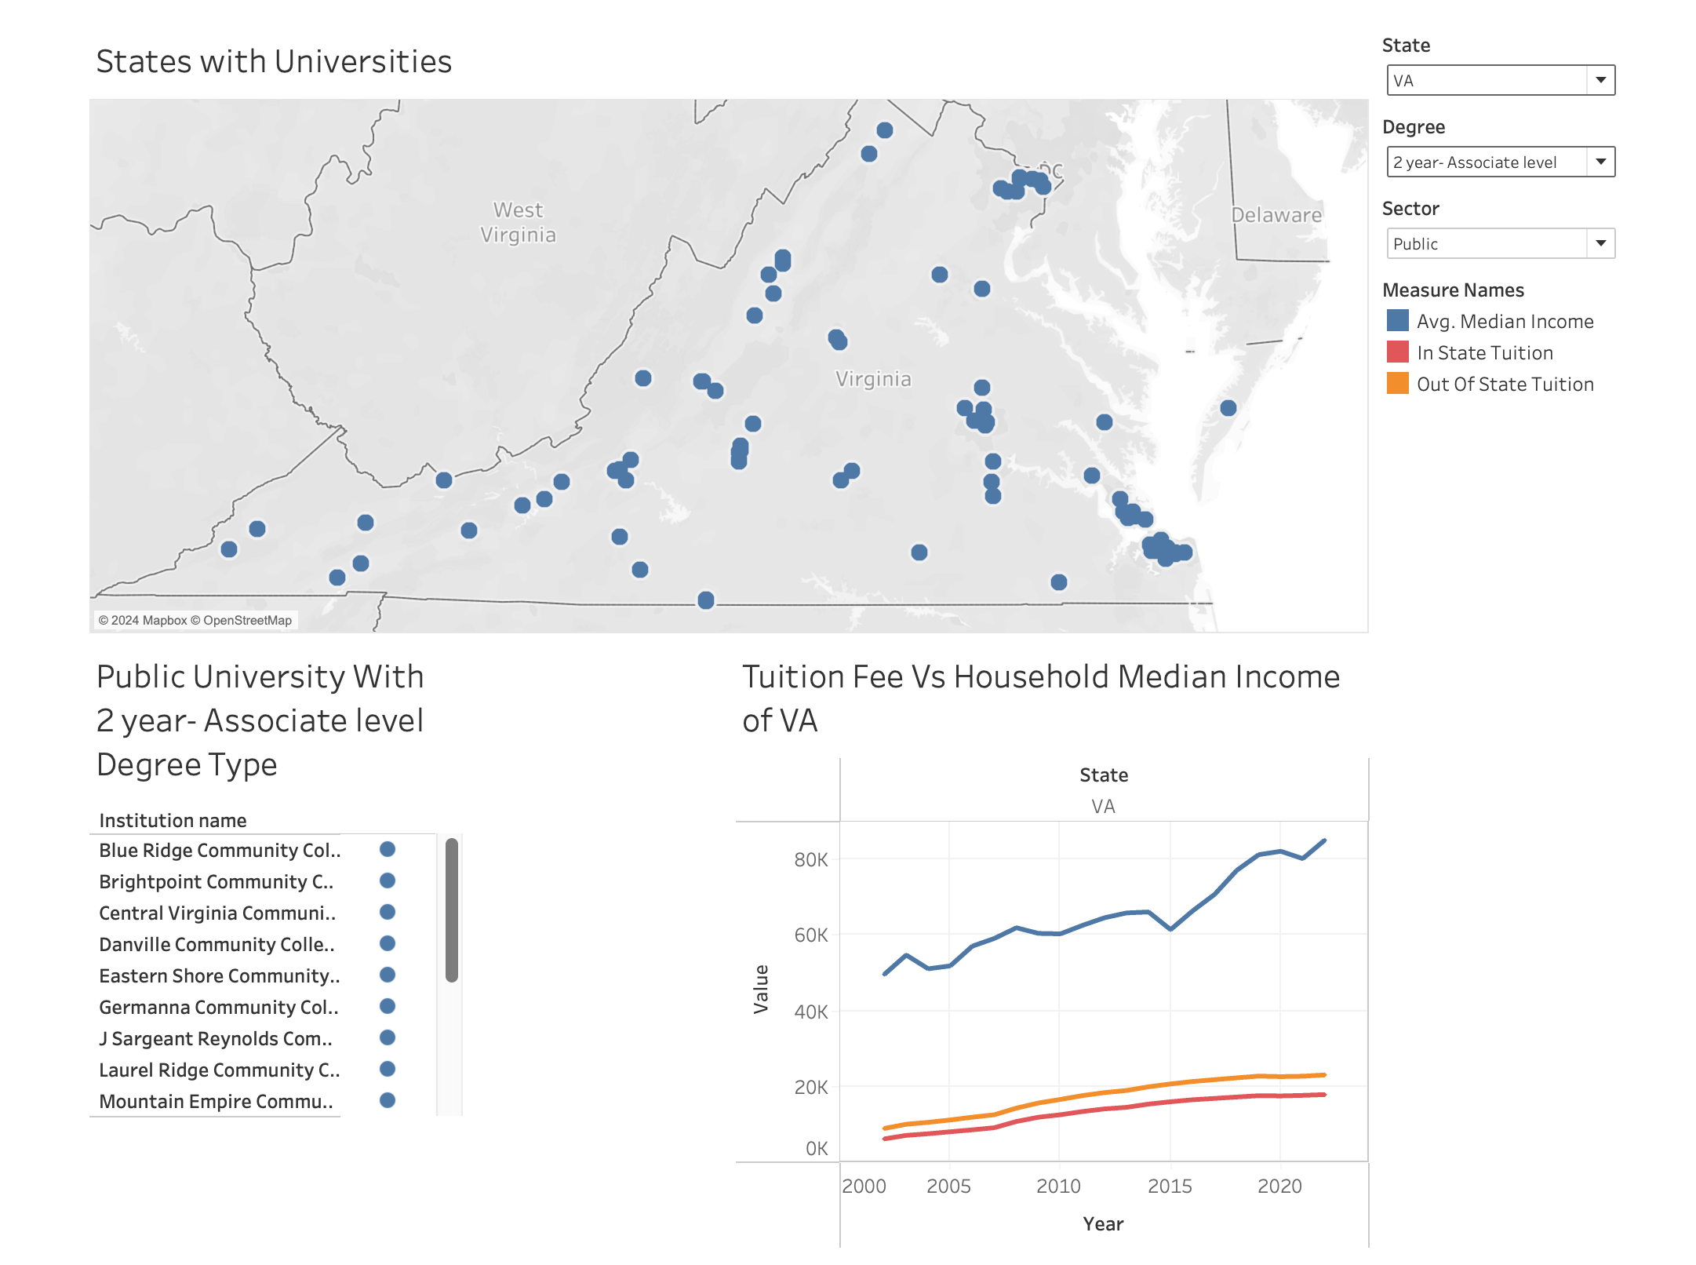
Tuition Fees Relative to Household Median Income
https://public.tableau.com/app/profile/chaitanya.pallamreddy/viz/TuitionFeeVsMedianIncome/Dashboard1

Slide 15
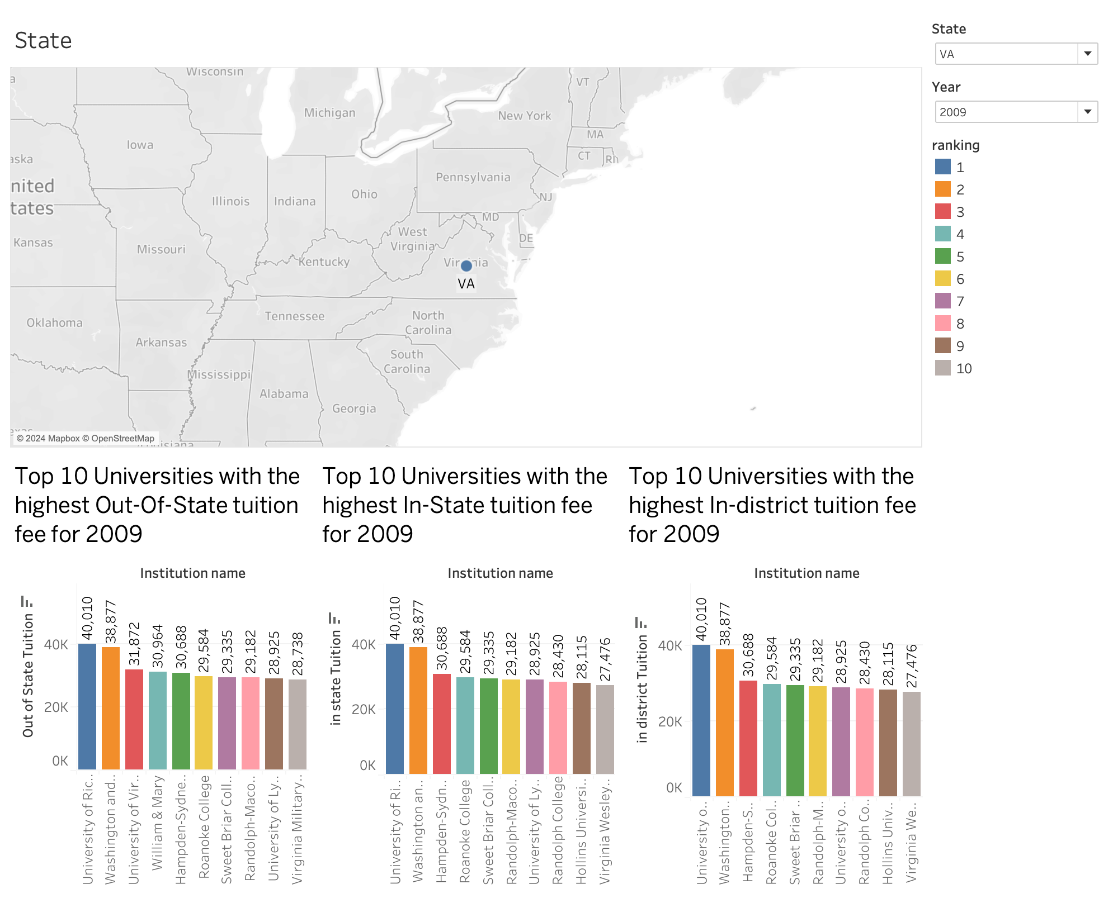
Top 10 Universities in each State
https://public.tableau.com/app/profile/chaitanya.pallamreddy/viz/TuitionFeeVsMedianIncome/Dashboard1

Slide 17

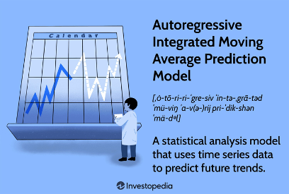
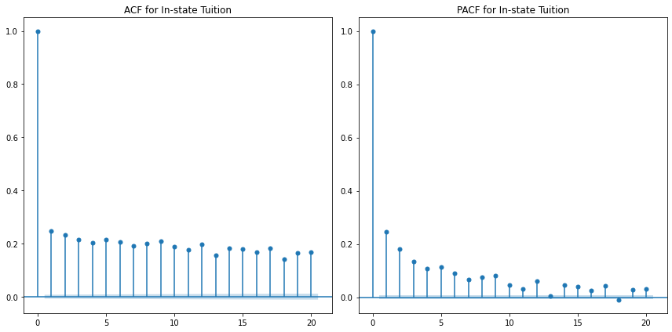
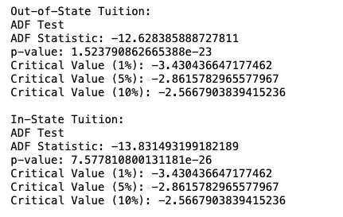

Machine Learning
Time Series Forecasting using ARIMA model
Data Preprocessing:
Index Setting: Set the 'Year' as the datetime index to facilitate time series analysis.
Time Formatting: Converted 'Year' column to datetime format.
Parameter Selection:
Statistical Tests: Used the Augmented Dickey-Fuller test to confirm stationarity of the data, indicating d=0..
ACF and PACF Analysis: to determine p=1 and q=1.
ADF Test Stats

Slide 18
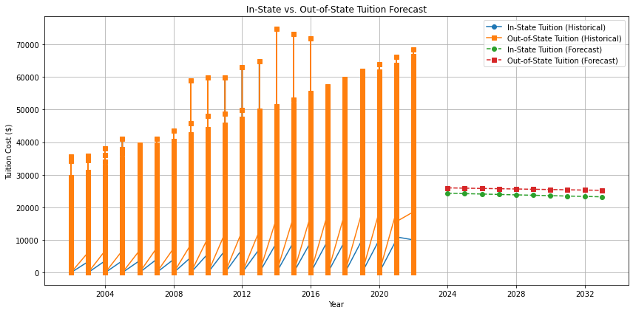

Machine Learning
Time Series Forecasting using ARIMA model
Forecasted Results

Slide 19
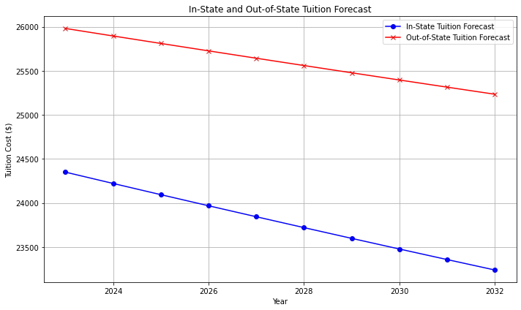
Forecasted Tuition for the upcoming decade using ARIMA Time series Forecasting

Slide 20
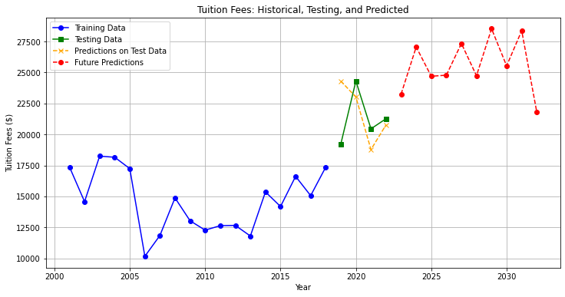
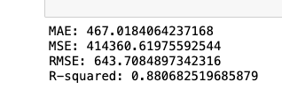
Predicting Out-of-State Tuition Fees with Linear Regression
Forecasted results
Evaluation metrics

Slide 21
Summary
This project proposes an interactive dashboard linking tuition hikes to regional median household incomes, empowering stakeholders to advocate for policy changes.
180%
Current total student loan debt is over $1.7 trillion.
Major issue
Statistics
Affects
The research highlights the major issue of rising US higher education tuition rates and their unequal impact on accessibility, especially for socioeconomically deprived persons.
The NCES reports show that the average total cost for a bachelor's degree has increased by approximately 180% over the past 20 years, confirming the significant rise.
This trend raises economic inequality by hindering social mobility. Public budget cuts and institutional actions have escalated costs.

Slide 22

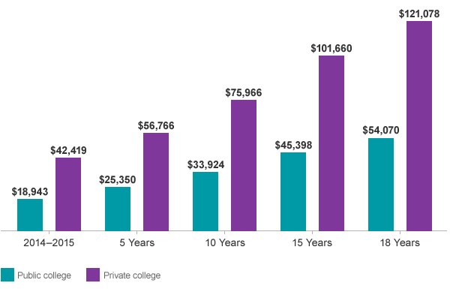


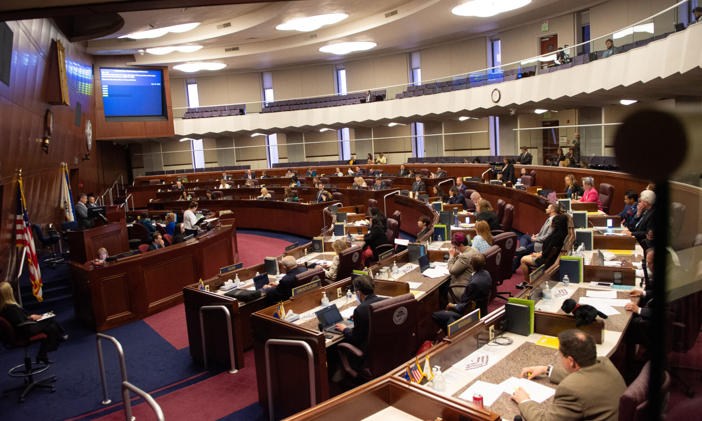
FUTURE ROADMAP
Incorporation of Additional Data Sources
Predictive Modeling for Future Tuition Trends
Collaboration with Educational Institutions
2028
Engagement with Lawmakers for Legislative Reforms
Creation of Educational Tools and Workshops

Slide 23


Q&A:
Q&A:

Slide 24

THANK YOU

